Slide 1
Data Literacy Program
Dr Kyaw Thu Swe
M&E Manager
EHSSG

Slide 2
Introduction Session
Notes:
15 mins

Slide 3
Pre-test Session
https://forms.gle/2Z2LoajdEKHDWkZy5
Notes:
15 mins

Slide 4
Importance of Data literacy in M&E

Slide 5
Importance of data literacy in M&E.
Informed Decision-Making
Data literacy enables stakeholders involved in M&E to interpret data accurately, leading to more informed decision-making processes.
It ensures that decisions are based on evidence rather than intuition or anecdote.
UNESCO. (2020). "Education for All 2000-2015: Achievements and Challenges."
Enhancing Accountability
With improved data literacy, organizations can more effectively track the progress of projects and programs, ensuring that resources are used efficiently and objectives are met.
This enhances accountability to stakeholders, including donors, governments, and the communities served.
World Bank. (2021). "World Development Report 2021: Data for Better Lives."

Slide 6
Importance of data literacy in M&E.
Improving Data Quality
A data-literate workforce is better equipped to collect, manage, and analyze high-quality data.
This is crucial for M&E, as the accuracy of findings and the validity of evaluations depend on the quality of data collected.
United Nations Development Programme (UNDP). (2019). "Guidance Note on Data Literacy."

Slide 7
Importance of data literacy in M&E.
Fostering Collaboration
Data literacy can foster a culture of collaboration and shared understanding among diverse stakeholders involved in M&E, including technical experts, program staff, and decision-makers.
The ability to communicate data findings effectively bridges the gap between data professionals and non-technical stakeholders, facilitating collaborative efforts towards common goals.
Partnership for Public Service. (2018). "The Federal Data Strategy: Leveraging Data as a Strategic Asset."

Slide 8
Importance of data literacy in M&E.
Adapting to Technological Advancements
As M&E practices increasingly incorporate advanced technologies such as big data analytics, artificial intelligence, and machine learning, data literacy becomes even more crucial.
Understanding these technologies and their implications for data collection and analysis enhances the ability to adapt and innovate within the field of M&E.
OECD. (2015). "Data-Driven Innovation: Big Data for Growth and Well-Being."
Notes:
15 mins

Slide 9
Overview of monitoring and evaluation (definitions, purposes, differences).

Slide 10
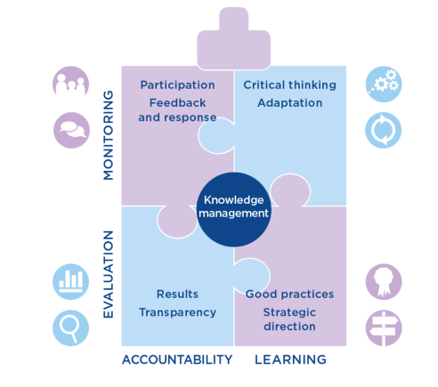
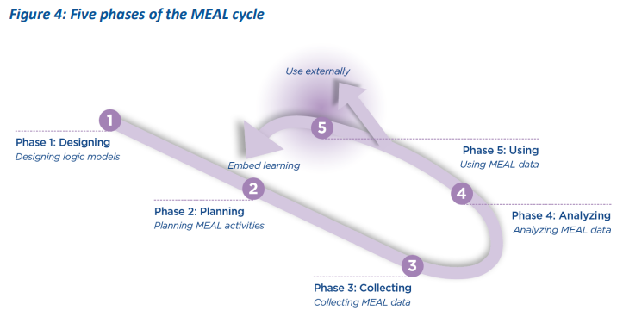
The MEAL cycle and MEAL puzzle

Slide 11
Definitions
Monitoring and Evaluation are critical components of the Program Management Cycle, essential for assessing the progress and impact of projects and programs.
Monitoring is the continuous and systematic process of collecting, analyzing, and using information to track a program's progress towards achieving its objectives.
It's an integral part of day-to-day management and operational oversight, focusing on the extent to which input deliveries, work schedules, targeted outputs, and other intended results are actually being achieved.
Monitoring helps in making adjustments and decisions to ensure the program's success and efficiency in real-time​​.

Slide 12
Definitions
Evaluation involves a more detailed and systematic assessment of a program's design, implementation, and outcomes.
This process aims to determine the relevance, impact, effectiveness, efficiency, and sustainability of interventions after they have been implemented.
Evaluation helps understand why certain outcomes were or were not achieved, providing insights for future programming and decision-making​​.

Slide 13
Purposes
The purpose of monitoring is to provide project managers and stakeholders with regular feedback and early indications of progress or lack thereof.
This facilitates timely adjustments to strategies and actions to ensure the achievement of desired outcomes.
Monitoring's ongoing nature supports accountability, informed decision-making, and resource allocation​​.

Slide 14
Purposes
The purpose of evaluation is to assess the achievement of outcomes and impacts against set goals and objectives.
Evaluations are conducted at specific points in time to provide an evidence-based analysis of whether or not a program achieved its objectives, how it did so, and why certain outcomes occurred.
This helps in learning from experiences, improving future program design, and demonstrating accountability to stakeholders​​.

Slide 15
Differences
Timing and Frequency: Monitoring is an ongoing process that takes place throughout the life cycle of a program. Evaluation, on the other hand, is performed at strategic points, usually mid-term or at the end of a program, to assess its overall effectiveness and impact​​.
Focus and Scope: Monitoring focuses on the process, activities, and outputs to ensure the program is on track. Evaluation looks at outcomes and impacts to understand the program's broader effects and its value.

Slide 16
Differences
Data and Methods: Monitoring typically uses quantitative data collected systematically. Evaluation often incorporates both quantitative and qualitative data, requiring more complex methodologies to understand the reasons behind certain outcomes​​.
Usage of Results: Monitoring results are used for day-to-day management and decision-making. Evaluation results contribute to strategic planning, policy formulation, and program improvement.
Notes:
20mins

Slide 17
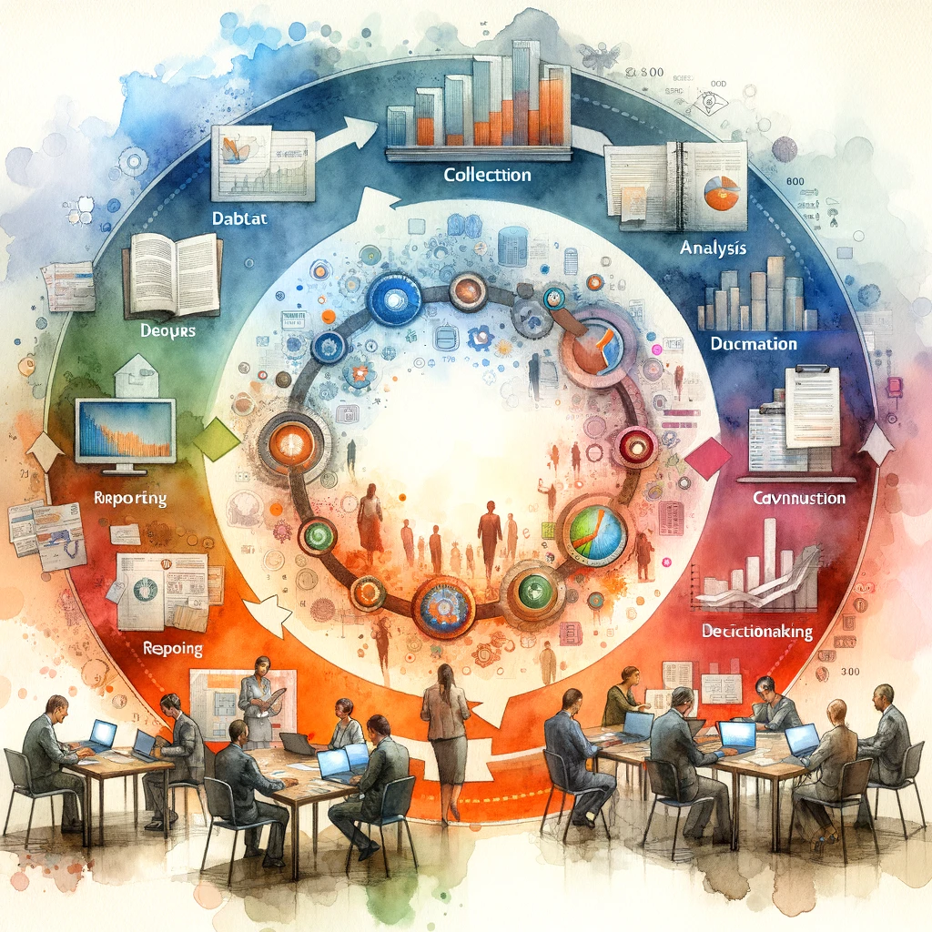
The data lifecycle in M&E projects

Slide 18
The data lifecycle in M&E/MEAL projects is a crucial framework that ensures the effective management, use, and dissemination of data throughout the project lifecycle.

Slide 19
1. Planning and Design
Objective Setting: Define what information is needed to assess the project's effectiveness, impact, and sustainability.
Indicator Selection: Choose specific, measurable indicators that align with the project objectives.
Data Collection Methodology: Decide on the methods for data collection, including surveys, interviews, focus groups, or secondary data analysis.

Slide 20
2. Data Collection
Preparation: Develop data collection tools, such as questionnaires or interview guides, and train data collectors.
Implementation: Carry out data collection activities, ensuring adherence to the planned methodology and ethical standards.
Quality Assurance: Implement mechanisms to ensure the accuracy and reliability of the data collected, such as pilot testing tools or conducting data verification checks.

Slide 21
3. Data Processing
Entry and Cleaning: Input data into databases and conduct initial cleaning to remove errors or inconsistencies.
Coding and Categorization: Apply codes to qualitative data and organize data into categories or themes for analysis.
Data Validation: Use techniques like double data entry or data triangulation to validate the data.

Slide 22
4. Data Analysis
Quantitative Analysis: Employ statistical methods to analyze numerical data, identifying trends, patterns, and relationships between variables.
Qualitative Analysis: Analyze texts, interviews, or observations to extract meaningful insights and interpretations.
Synthesis: Integrate findings from both quantitative and qualitative analyses to draw comprehensive conclusions.

Slide 23
5. Data Interpretation and Reporting
Interpretation: Discuss the implications of the findings in relation to the project's objectives, context, and existing literature or theories.
Report Writing: Prepare reports that present the data, methodology, findings, and recommendations in a clear and accessible format.
Feedback and Validation: Share preliminary findings with stakeholders to validate interpretations and gather feedback.

Slide 24
6. Data Use and Dissemination
Decision Making: Utilize the findings to inform project decisions, policy formulation, and strategic planning.
Dissemination: Share the results with a wider audience through presentations, publications, or online platforms.
Knowledge Sharing: Contribute to the broader knowledge base of the field by making data and insights available for learning and adaptation.

Slide 25
7. Evaluation and Learning
Reflect on Process: Evaluate the effectiveness of the data lifecycle processes and identify areas for improvement.
Incorporate Lessons Learned: Apply insights gained from this reflection to enhance future M&E practices.
Decision-making: Data-driven decisions improve project implementation and resource allocation.
Adaptive management: Adjust the project as needed based on the evidence from M&E.
Knowledge sharing: Disseminate lessons learned to improve future projects and contribute to the broader field.
Notes:
20mins

Slide 26
Data literacy concepts and competencies
Notes:
15mins

Slide 27
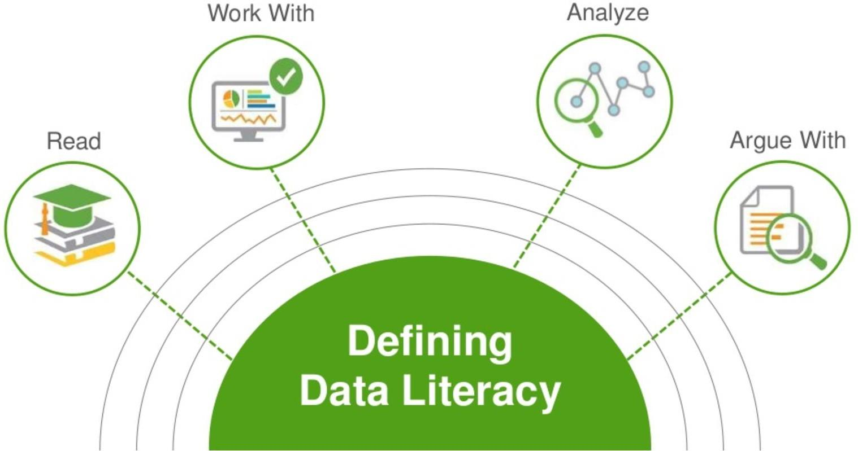
What is data literacy ???
"the ability to read, work with, analyze and argue with data."
It highlights not just the technical skills involved in handling data, but also the critical thinking required to engage with and make arguments based on data (The Data Literacy Project, n.d.).
© Copyright National University of Singapore. All Rights Reserved.

Slide 28
What is data literacy ???
Data literacy encompasses the skills and competencies necessary for individuals to access, interpret, critically assess, manage, handle, and ethically use data.
It is increasingly recognized as a crucial skill set in the modern information-driven world, where data impacts many aspects of daily life, from personal decisions to the global economy.

Slide 29
The Devil’s in the Details
© Copyright National University of Singapore. All Rights Reserved.

Slide 30
1. Understanding Data Basics
2. Data Collection and Management
Concepts: Types of data (quantitative vs. qualitative), data formats, and the significance of data in various contexts.
Competencies: Identifying relevant data types for specific situations and understanding the basics of data structures.
Concepts: Methods of data collection, data sourcing, data storage, and data governance.
Competencies: Skills in collecting data ethically, storing data securely, and managing data in accordance with legal and ethical standards.

Slide 31
3. Data Processing and Cleaning
4. Data Analysis
Concepts: Data preprocessing, cleaning techniques, and data transformation.
Competencies: Ability to clean and preprocess data for analysis, including handling missing values and removing duplicates.
Concepts: Statistical analysis, data mining, and data visualization.
Competencies: Applying statistical methods and visualization techniques to interpret data and draw conclusions.

Slide 32
7. Ethical Use of Data
Concepts: Data privacy, security, and ethical use of data.
Competencies: Understanding and applying ethical principles in the use of data, including considerations of privacy and data protection.

Slide 33
Data Literacy Competencies
While there's no single standard, some commonly recognized competencies include:
Critical thinking: Evaluating data sources, questioning assumptions, identifying biases, and drawing sound conclusions.
Problem-solving: Framing data-driven questions and using data to find solutions.
Communication: Clearly and effectively presenting data insights to various audiences, both verbally and visually.
Technical skills: Proficiency in using spreadsheets, data analysis tools, and potentially programming languages (e.g., Python, R) for advanced tasks.
Data ethics: Understanding privacy, confidentiality, and the responsible use of data.

Slide 34
1. Understanding Data Basics

Slide 35
What is data ???
Data is a value assigned to a thing.
Data refers to factual information or observations used as a basis for reasoning, discussion, or calculation.
It can be collected from various sources and presented in multiple forms, such as numbers, words, measurements, or images.
Data is typically used to represent the characteristics or attributes of something, providing insight or evidence that can inform decisions, hypotheses, or conclusions.
In its simplest form, data can be a single piece of information, but when collected and analyzed in volume, it can reveal patterns, trends, and associations.

Slide 36
Types of Data
1. Quantitative Data
Quantitative data is numerical and can be measured and expressed in numbers.
It's used to quantify the characteristics of a group or set of entities, allowing for statistical analysis and mathematical calculations.
Quantitative data is further divided into two types:
Discrete Data: Consists of countable values that can only take specific values within a range. Examples include the number of students in a class or the number of cars in a parking lot.
Continuous Data: Can take any value within a given range and can be divided into finer subdivisions. Measurements like height, weight, and temperature are examples of continuous data.

Slide 37
Types of Data
2. Qualitative Data
Qualitative data is descriptive and characterizes but does not measure attributes.
It's often collected through observations, interviews, and surveys.
This type of data is subdivided into:
Nominal Data: Categories that do not have a natural order or ranking.
Examples include gender, nationality, or hair color.
Ordinal Data: Similar to nominal data, but there is a clear order or ranking among the categories.
Examples include education level (e.g., high school, undergraduate, graduate), satisfaction ratings (e.g., satisfied, neutral, dissatisfied), or economic status (e.g., low, middle, high income).

Slide 38
Types of Data
3. Primary and Secondary Data
Primary Data: Collected directly from the source for a specific research purpose or project.
This type of data is original and collected firsthand through surveys, experiments, interviews, etc.
Secondary Data: Already existing data collected by someone else for a different purpose but used by researchers for a new study.
Examples include data from books, journals, reports, or previously conducted studies.

Slide 39
Types of Data
4. Structured and Unstructured Data
Structured Data: Highly organized and formatted in a way that is easily searchable by simple, straightforward search engine algorithms or other search operations. It's typically stored in databases. Examples include names, dates, addresses, credit card numbers, and stock information.
Unstructured Data: Not organized in a predefined manner, making it difficult to collect, process, and analyze without sophisticated tools.
Examples include text files, emails, social media posts, videos, audio files, and images.

Slide 40
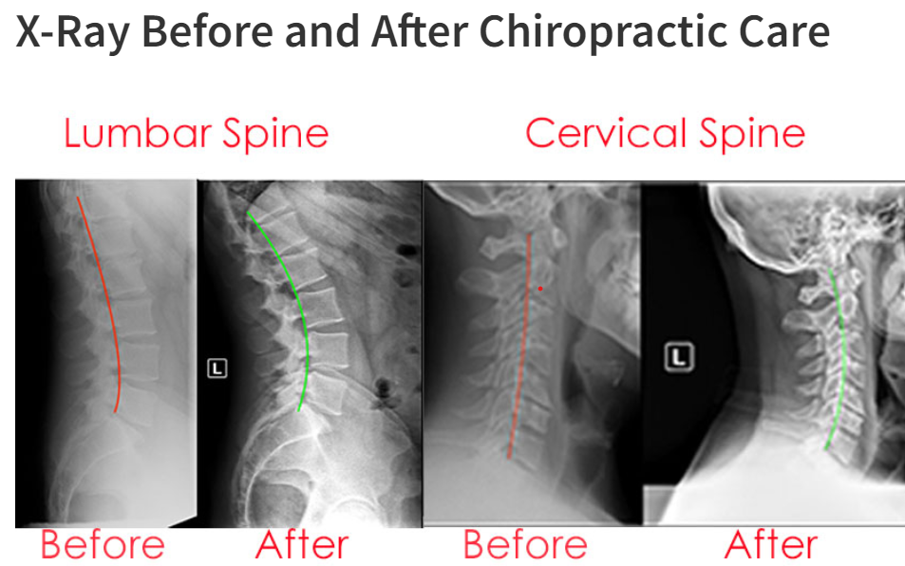
Types of Data
5. Time-series Data, Cross-sectional Data, and Panel Data
Time-series Data: Observations of a single variable or several variables over time, such as the daily closing price of a stock or yearly rainfall measurements.
Cross-sectional Data: Data collected from multiple subjects at a single point in time or without regard to differences in time. Examples include a survey of voters' preferences taken on a single day.
Panel Data (or Longitudinal Data): Combines both time-series and cross-sectional data by observing multiple subjects over a period of time. Examples include a study tracking the same individuals' income levels over five years.

Slide 41
Data formats
Data formats are essential for the efficient storage, exchange, and processing of information. Understanding different data formats is crucial for data literacy.
1. Text-Based Formats
CSV (Comma-Separated Values)
JSON (JavaScript Object Notation)
XML (eXtensible Markup Language)
2. Binary Formats
PDF (Portable Document Format)
Microsoft Excel (XLS, XLSX)
3. Image Formats
JPEG (Joint Photographic Experts Group)
PNG (Portable Network Graphics)
4. Audio and Video Formats
MP3 (MPEG Audio Layer III)
MP4 (MPEG-4 Part 14)
5. Database and Big Data Formats
SQL (Structured Query Language) Databases - MySQL,Oracle, Microsoft SQL Server
NoSQL Databases
Notes:
1. Text-Based Formats
CSV (Comma-Separated Values) - Structure: Data is formatted in plain text, with commas separating each field and new lines indicating new records.
JSON (JavaScript Object Notation) - Structure: Data is formatted in key-value pairs, making it easy to read for humans and parsable by machines. It supports arrays and nested objects.
Use Cases: Commonly used in web applications for data interchange between clients and servers, as well as in configuration files.
XML (eXtensible Markup Language)Structure: Data is enclosed between tags in a hierarchical structure, allowing for complex data representations.
Use Cases: Used for data interchange, in web services, and for configuration files, especially where document structure is important.
2. Binary Formats
PDF (Portable Document Format)
Structure: A file format used to present documents in a manner independent of application software, hardware, and operating systems. Combines text, graphics, and other information into a single document.
Use Cases: Ideal for documents intended for printing or professional publishing.
Microsoft Excel (XLS, XLSX)
Structure: Proprietary Microsoft formats for spreadsheets. XLSX is based on XML, while XLS is a binary format.
Use Cases: Widely used in business and academia for tabular data, complex calculations, pivot tables, and visualizations.
HDF5 (Hierarchical Data Format version 5)
Structure: Designed to store and organize large amounts of numerical data. It supports a variety of data types and is efficient for storing complex hierarchical data structures.
Use Cases: Widely used in scientific research for storing large datasets, such as satellite imagery or computational simulation data.
3. Image Formats
JPEG (Joint Photographic Experts Group)
Structure: A commonly used method of lossy compression for digital images, particularly for those images produced by digital photography.
Use Cases: Ideal for photographs and realistic scenes with smooth variations of tone and color.
PNG (Portable Network Graphics)
Structure: A raster-graphics file-format that supports lossless data compression.
Use Cases: Used for images on the web, supporting transparency and without losing quality.
SVG (Scalable Vector Graphics)
Structure: An XML-based vector image format for two-dimensional graphics with support for interactivity and animation.
Use Cases: Ideal for logos, icons, and complex illustrations that need to scale without losing quality.
4. Audio and Video Formats
MP3 (MPEG Audio Layer III)
Structure: A standard format for audio and uses a form of lossy data compression.
Use Cases: Commonly used for storing music files and audiobooks due to its compression efficiency.
MP4 (MPEG-4 Part 14)
Structure: A digital multimedia container format most commonly used to store video and audio, but can also be used to store other data such as subtitles and still images.
Use Cases: Widely used for streaming media over the internet and for storing digital video and audio streams.

Slide 42
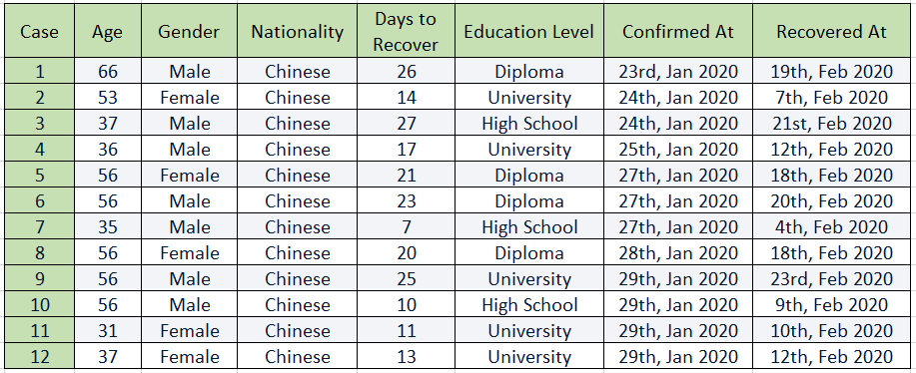
Types of Variables
Variable as a labeled box, and the data points are the items put inside the box.
Row
Column
© Copyright National University of Singapore. All Rights Reserved.

Slide 43
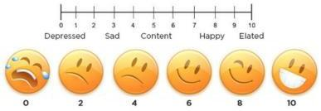
Types of Variables
Variables
Categorical
Numerical
Nominal
Ordinal
Discrete
Continuous
Nationality
Happiness Level
Academic Units (AUs)
Income
© Copyright National University of Singapore. All Rights Reserved.

Slide 44
Variables Types
Type of Variables | Feature | Examples
Categorical Nominal | Discrete categories with no definite order | Sex, Nationality, Colors, Win/lose in a game, ...
Categorical Ordinal | Discrete categories with values that can be ordered or ranked, yet, distances between values are incomparable | Satisfaction level, T-shirt sizes, Finishing place in a race, ...
Numerical Discrete | Measured with whole numbers, where distances between values are comparable | Academic units, Number of students in a class, ...
Numerical Continuous | Can take any numeric value on a continuous range | Income, Heights, Temperatures, ...
© Copyright National University of Singapore. All Rights Reserved.

Slide 45
Thank for your attention

